Slide 1
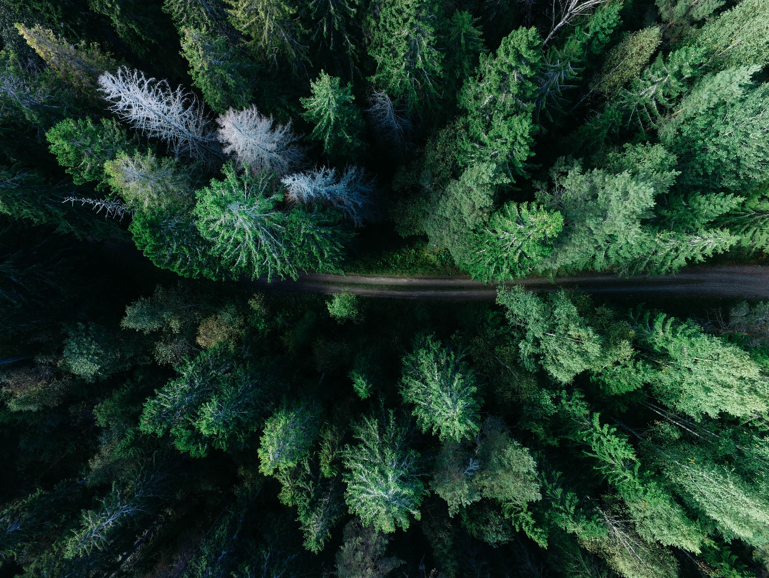

Data Science & AI
Capstone Project
An analysis on food production and the environmental impact
Vagner Bauer

Slide 2


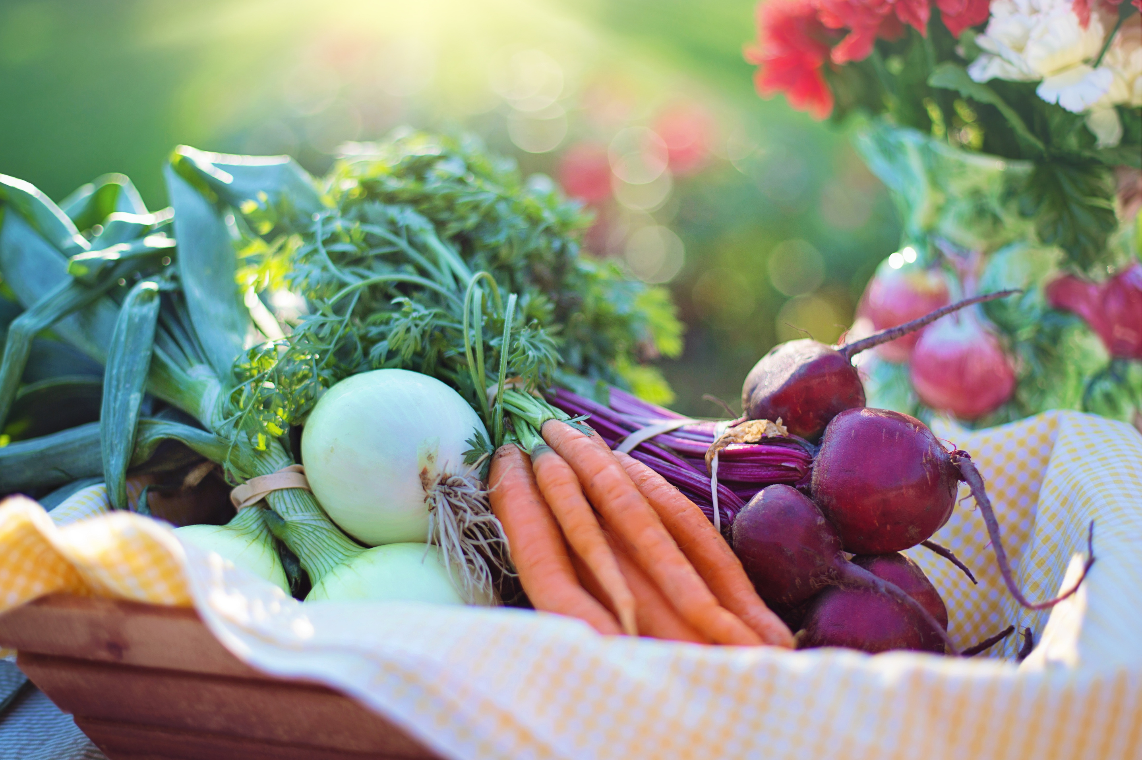
Agenda
03/
Business Question/Data Summary
05/
ML Algorithm
01/
Bio
02/
Project Context
04/
Process Flow/EDA
06/
Conclusions/Next Steps

Slide 3






Hi there again!
I'm Vagner, and
I'm a Food Scientist with a lot of interest in data science!

Slide 4
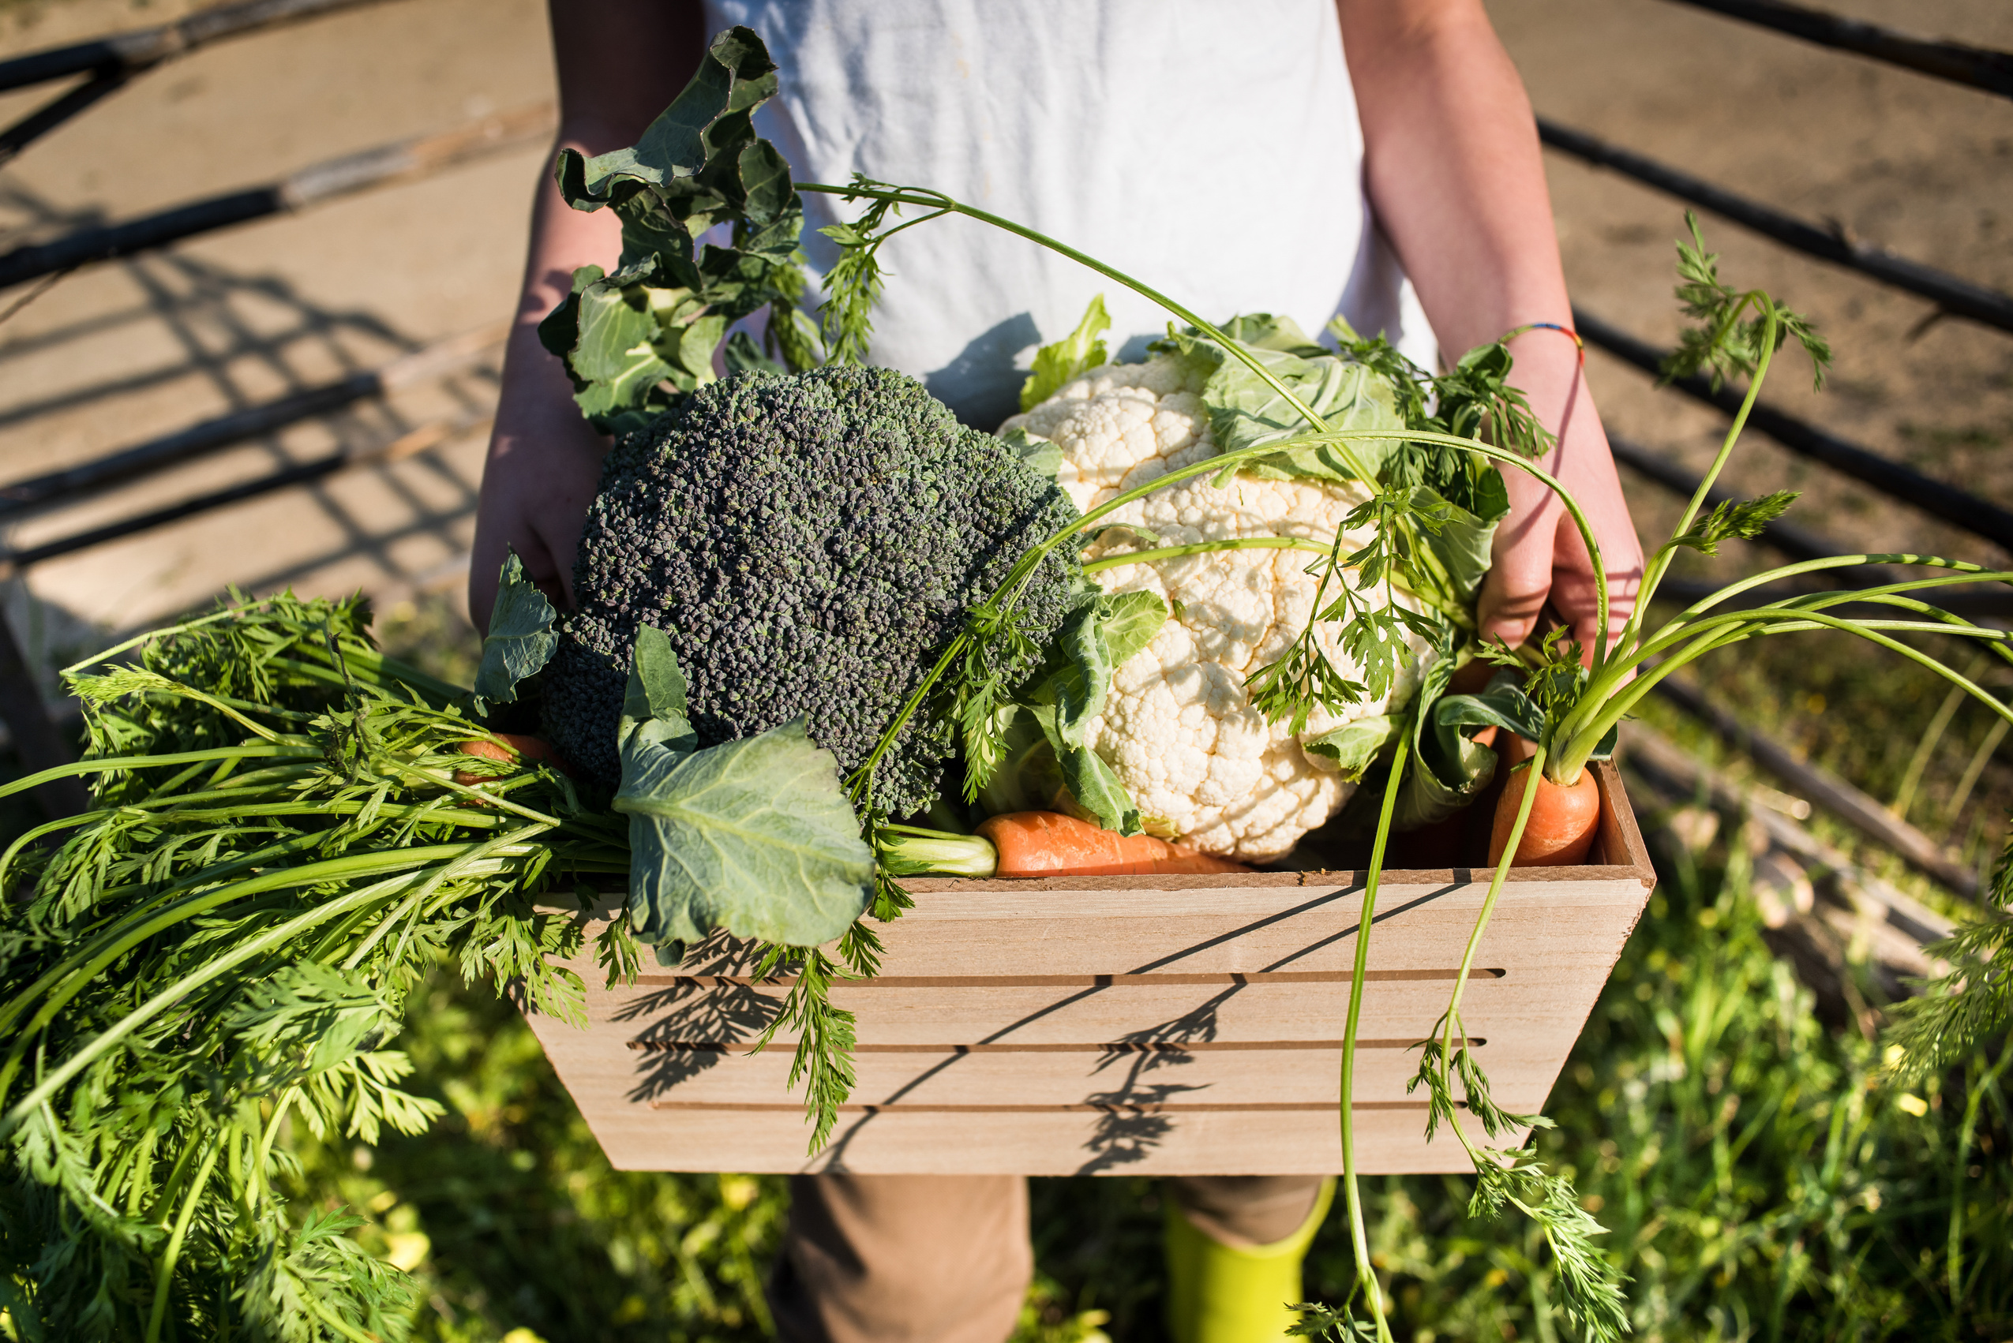
02/
Project Context
World's population is projected to reach 9.7 billion by 2050, according to the United Nations.
To meet the demands of this rapidly expanding population, food production has intensified, leading to significant environmental consequences.
How do we solve this problem?

Slide 5
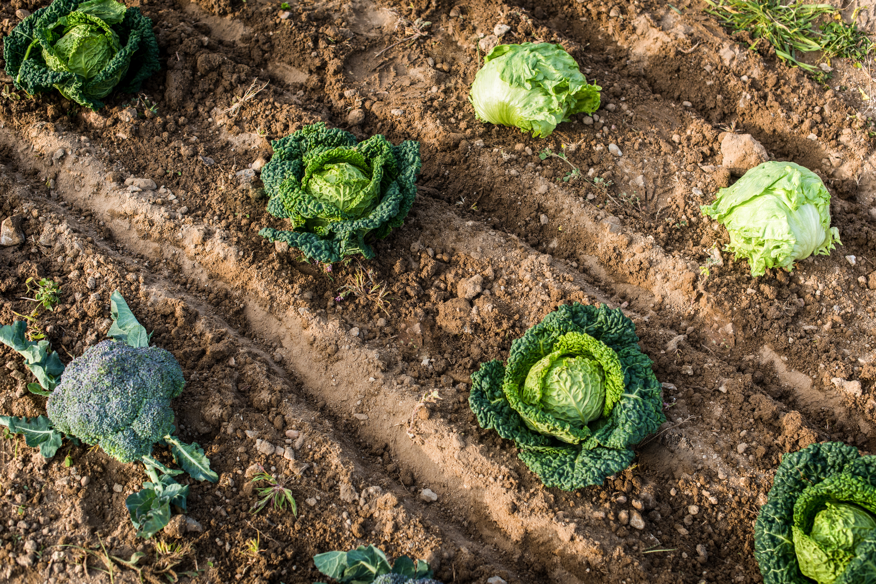
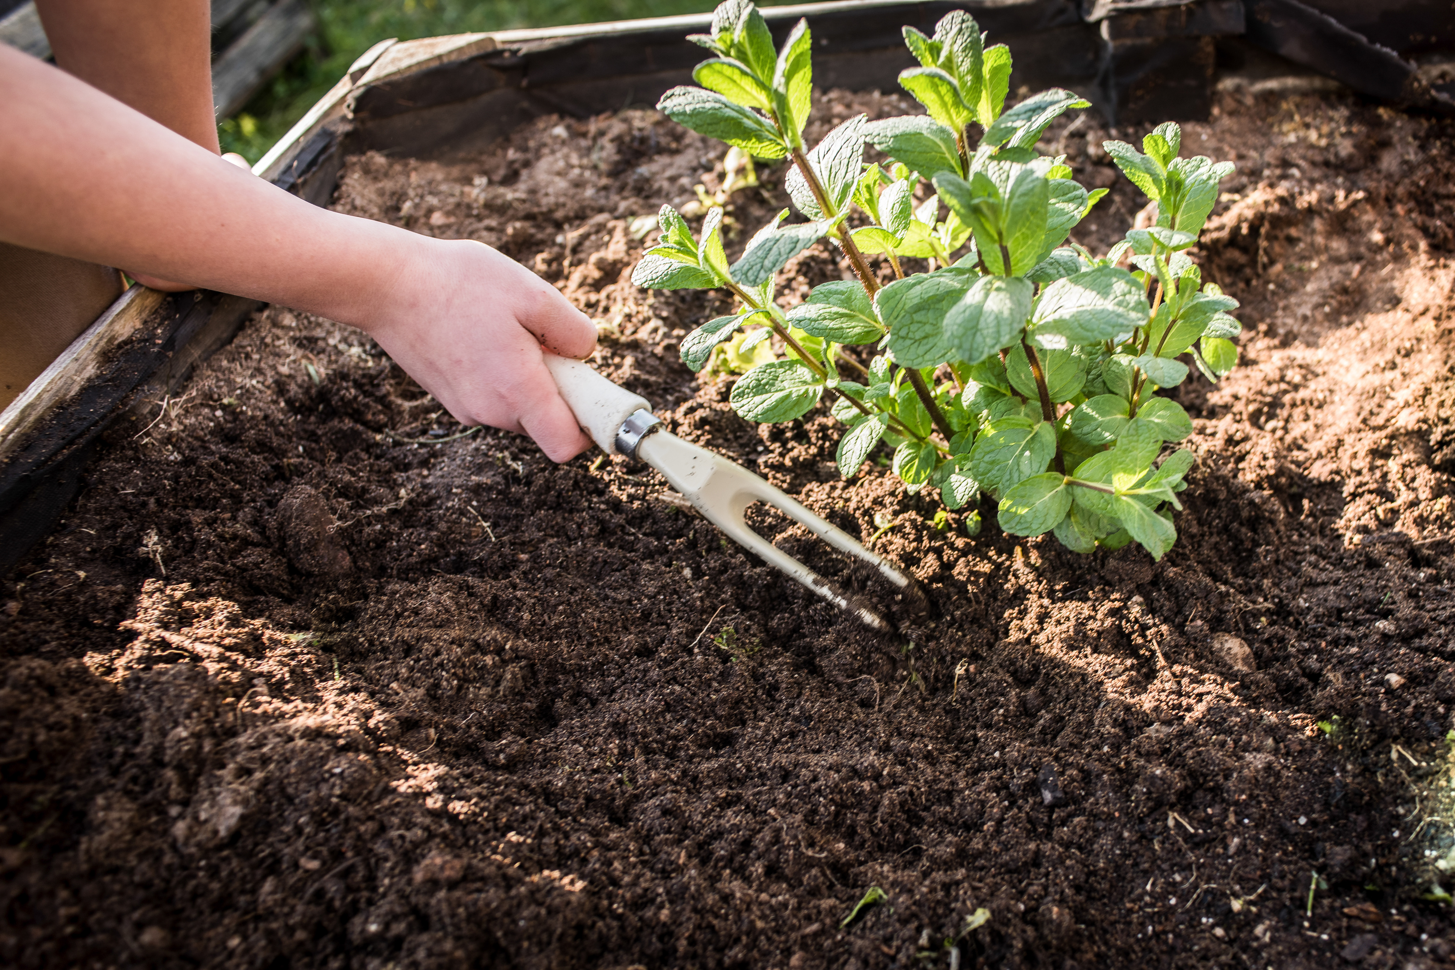
03/
Business Questions
1. What countries are the largest food producers?
2. What foods are the most produced in Australia and New Zealand?
3. What foods have the most negative impact on the environment in the food chain?
4. What is the environmental impact of shifting the protein source in a diet from beef to poultry?

Slide 6
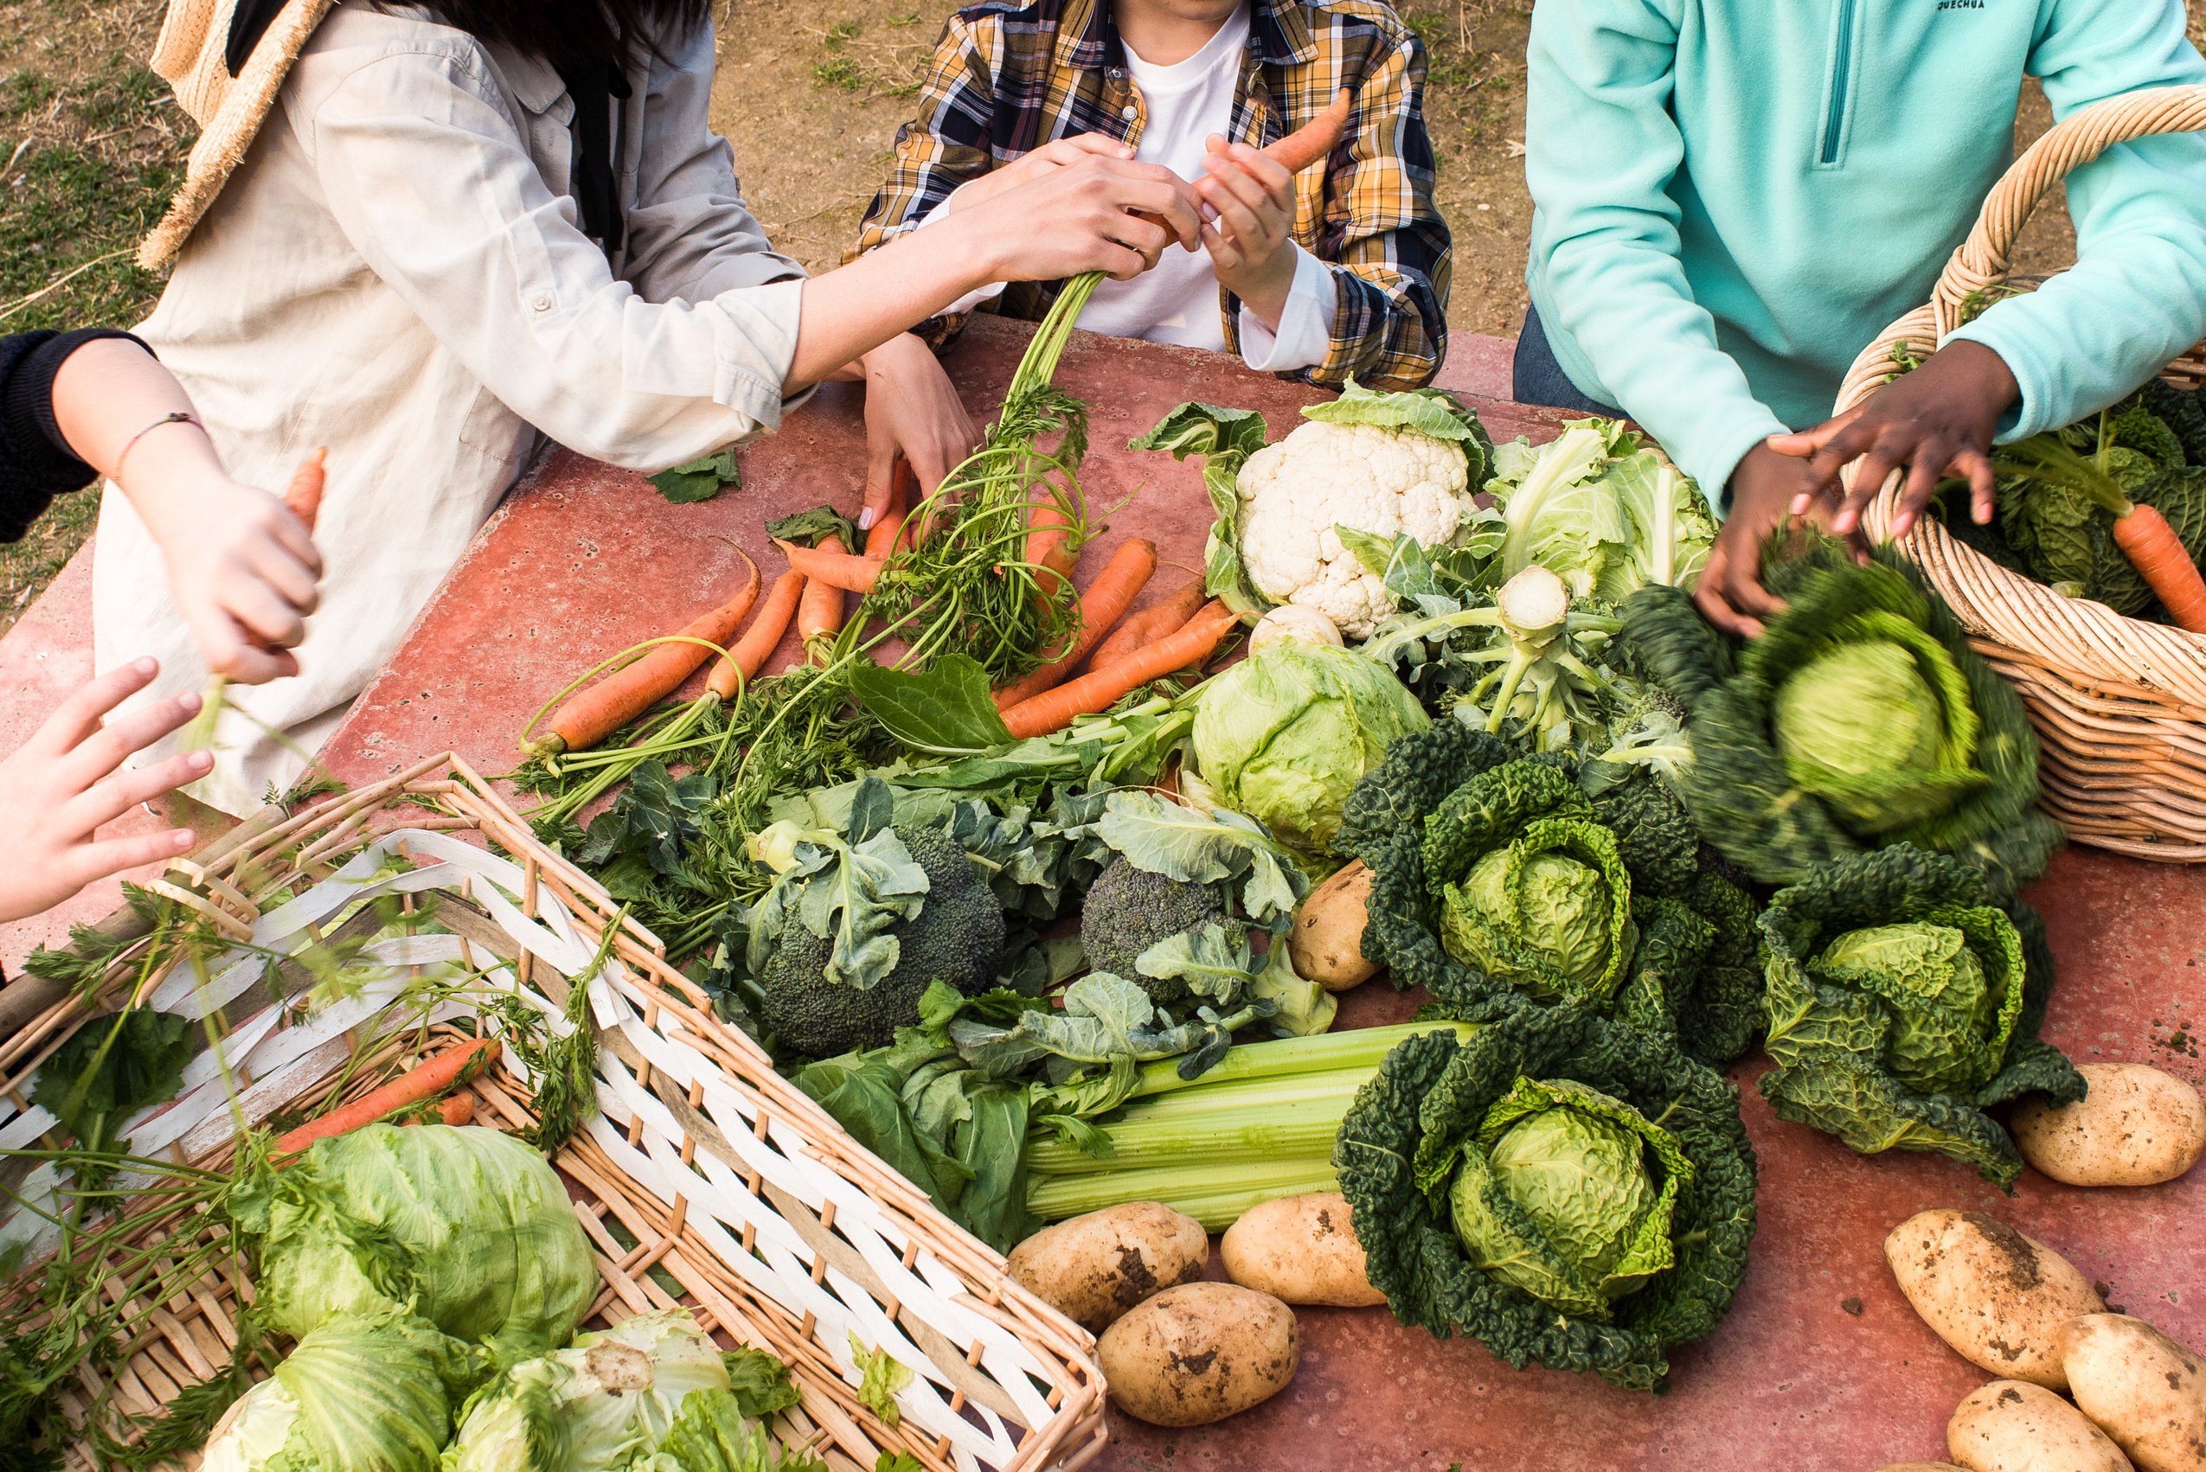


03/
Data Summary
Can we group in clusters different types of food based on their environmental impact?
Food production dataset (extracted from FAO website)
Data about production for different food products, countries and years (from 2010 to 2020)
14 features and 169234 observations -> 4 features.
Environmental impact of food production (extracted from Our World Data website)
Data from 2018 about most common food products and their impact on the environment (CO2 emissions, land use, water use).
7 features and 38 observations
5 continuous variables
2 categorical variables

Slide 7
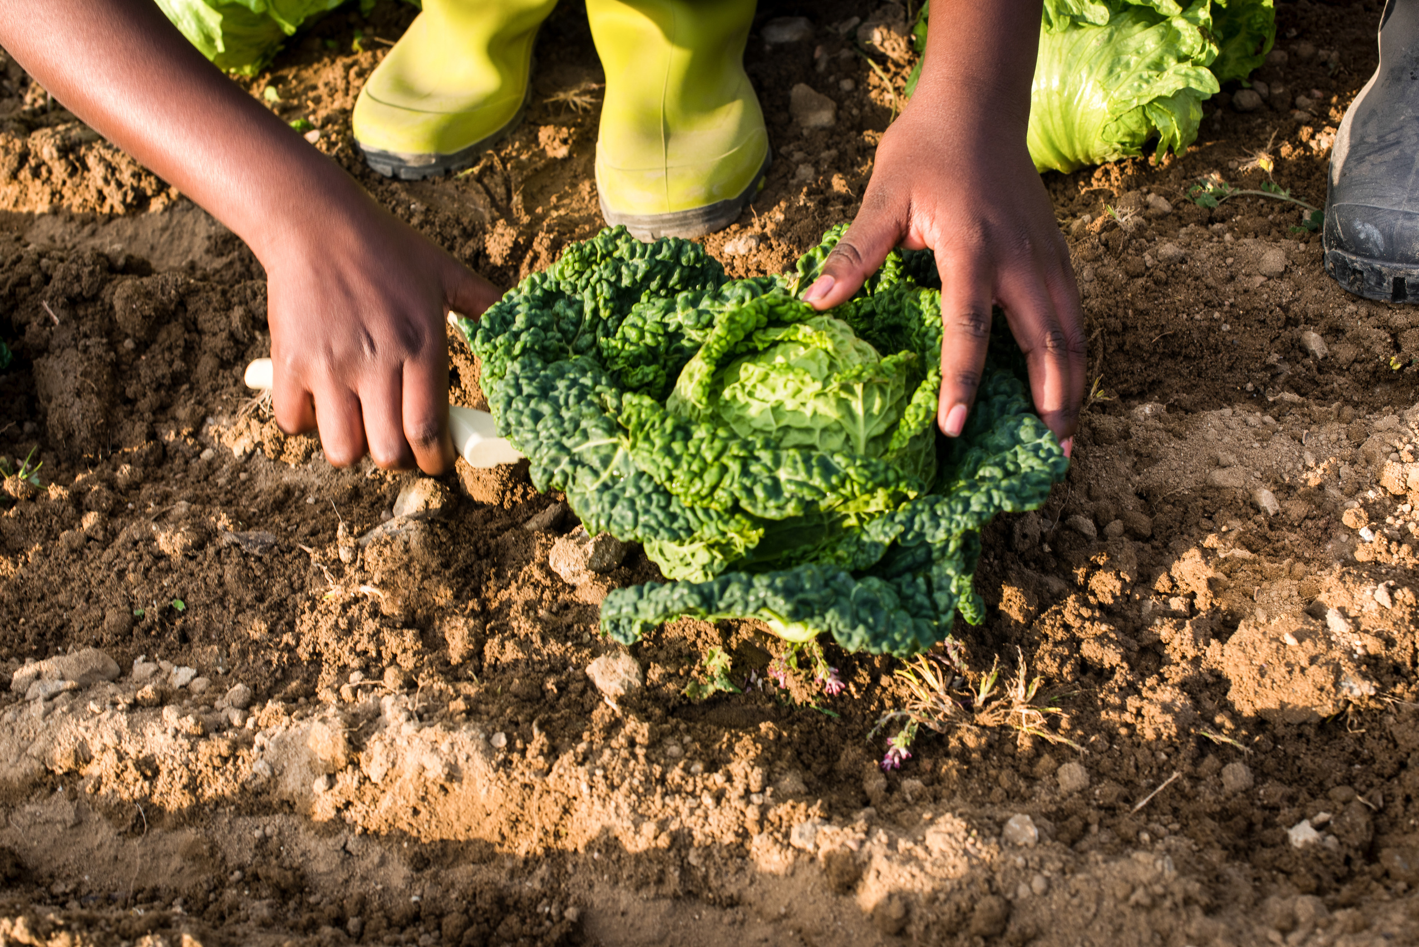








04/
Process
Flow
Communicate findings
Validate
Model
Explore
Clean
Pre Process

Slide 8
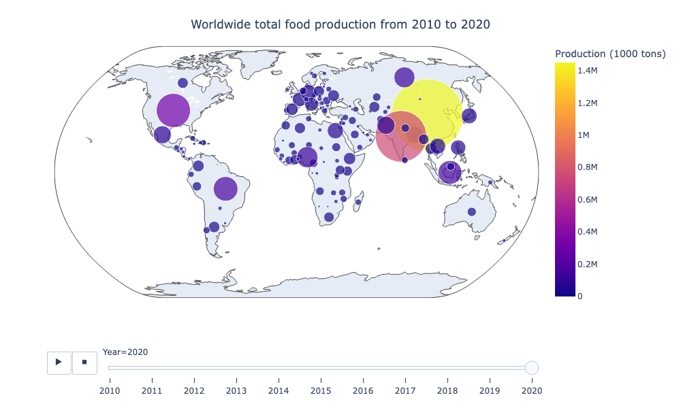
04/
EDA
China, India and the USA are the largest food producers in the world.
Australia and New Zealand are very tiny food producers compared to the rest of the world.
Australia food production was approximately 5 times bigger than New Zealand in 2020

Slide 9
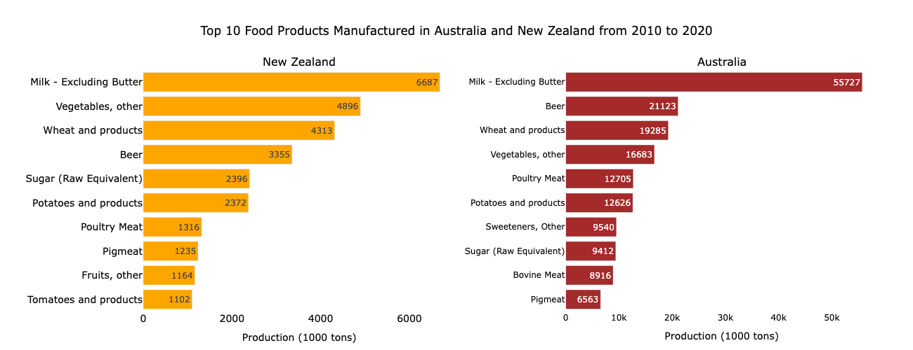
04/
EDA
Milk is the top food produced in both New Zealand and Australia. However, production in Australia is 8 times bigger than in New Zealand.
Production of foods derived from plant origin is predominant in both countries.

Slide 10
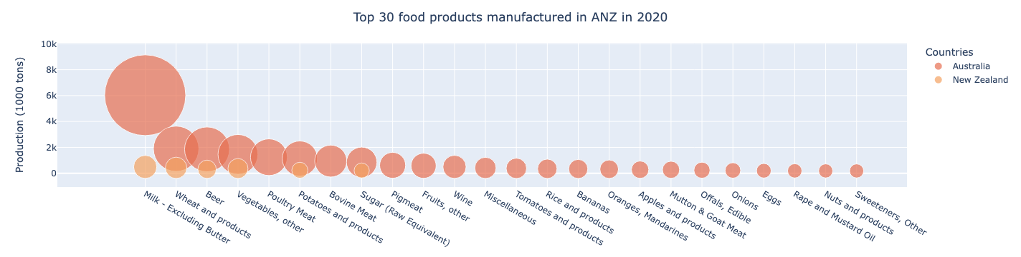
04/
EDA
Out of the top 30 food products manufactured in ANZ in 2020, New Zealand only has 6 on the list.

Slide 11
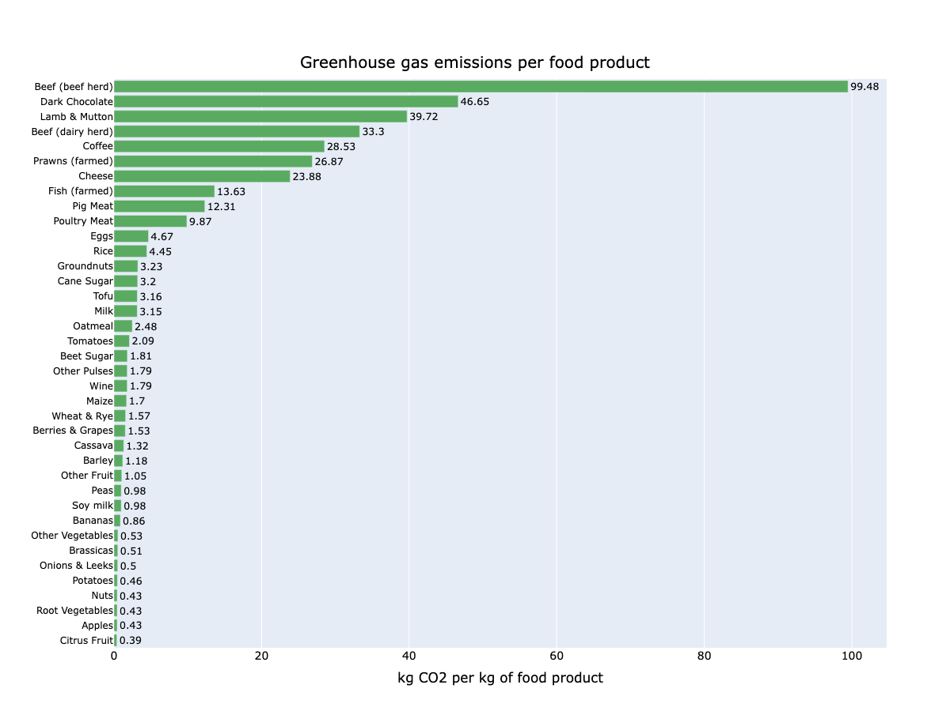
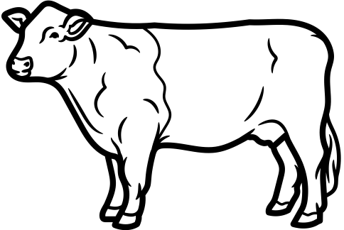
04/
EDA
The production of beef herd, dark chocolate and lamb & mutton generates more CO2 emissions.
Greenhouse gas emissions for the production of beef herd are 10x bigger than poultry.
Fruits and vegetables are in the other end of the spectrum.

Slide 12
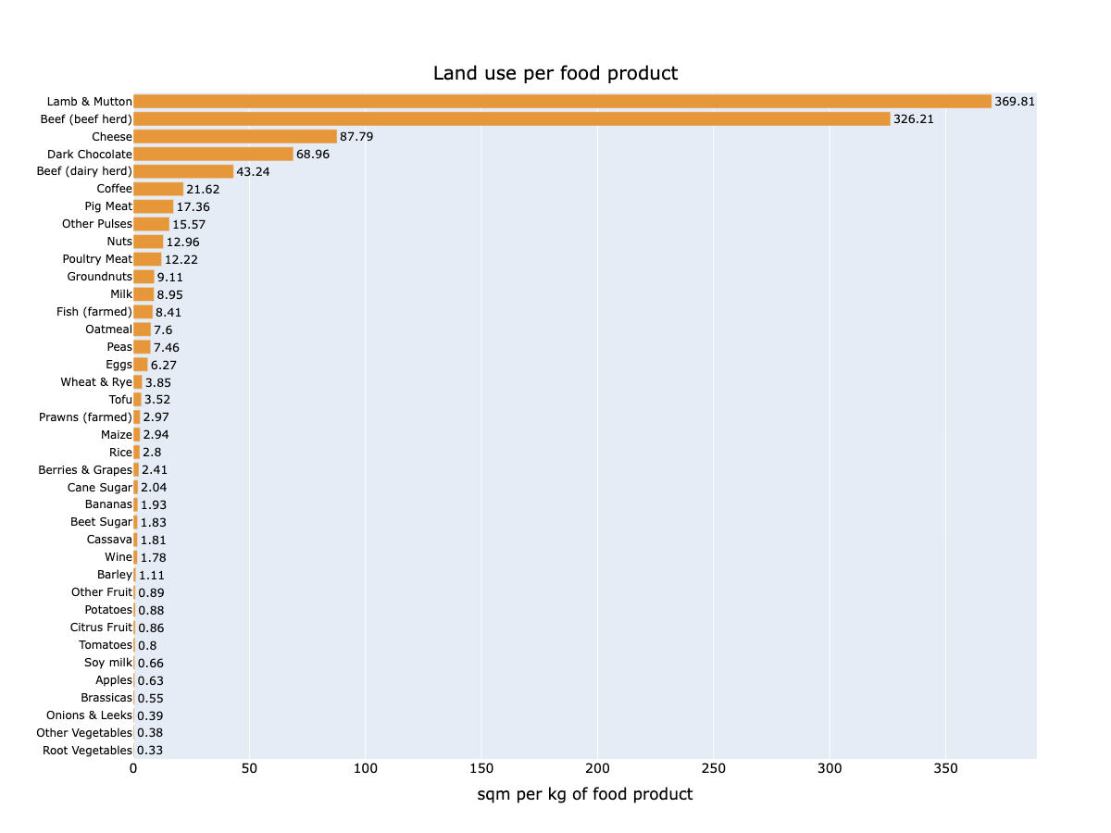

04/
EDA
The land used for the production of lamb & mutton and beef herd combined is greater than the sum of ALL of the other food products!

Slide 13
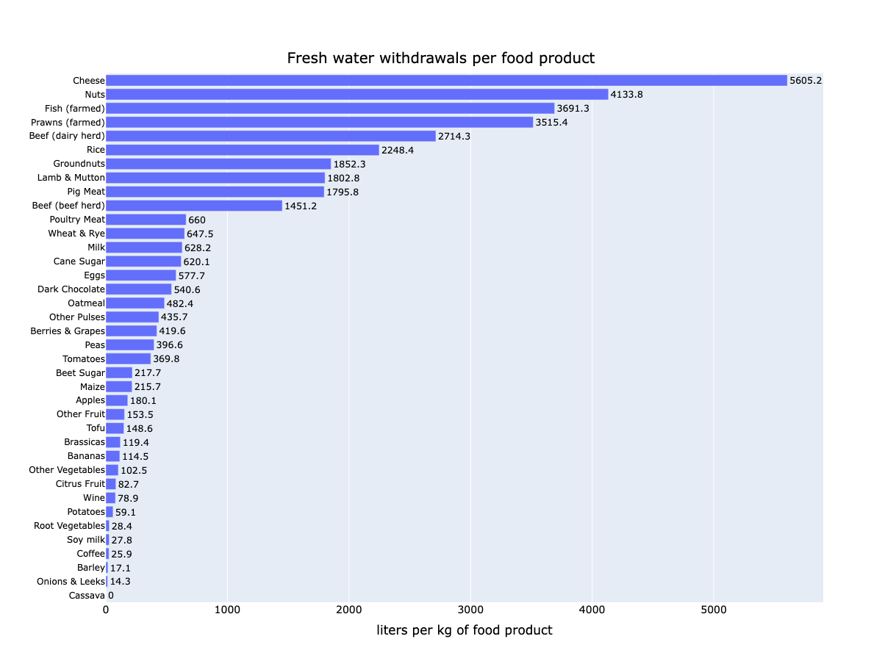

04/
EDA
Cheese, nuts and fish (farmed) are the products that have a higher number for freshwater withdrawals

Slide 14
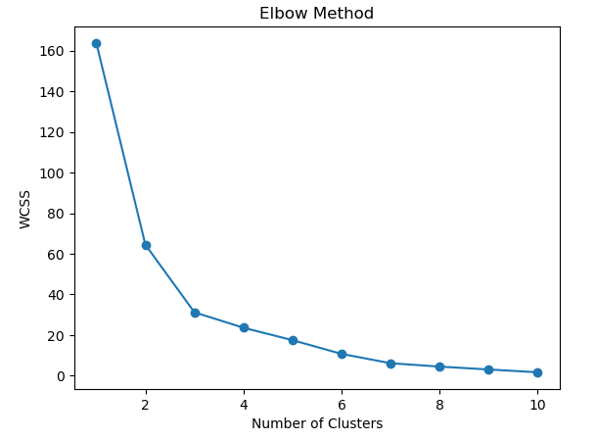
05/
ML algorithm
K-means for unsupervised learning
Application of StandardScaler to standardize features
Application of Principal Component Analysis (PCA) to reduce the dimensionality
Application of Elbow method to determine the number of clusters
Application of the silhouette method to confirm number of clusters
Ideal number of clusters = 3

Slide 15
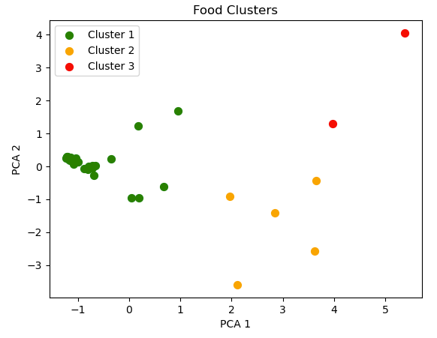
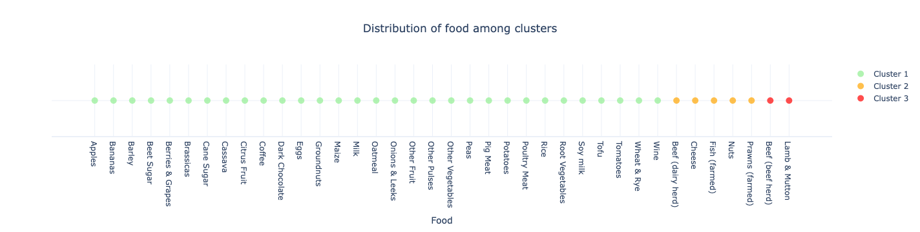
05/
ML algorithm
K-means for unsupervised learning
Beef herd and lamb & mutton are the food products with the highest impact on the environment.
Poultry meat is classified in cluster 1, the cluster with lowest environmental impact.

Slide 16



1 tonne of CO2 looks like:
06/
Conclusions
China, India and the USA are the largest food producers in the world.
Milk, vegetables, wheat and beer are the largest food production in Australia and New Zealand.
Beef herd and lamb & mutton are the food productions with the highest impact on the environment.
The average meat consumption per capita in Australia in 2020 was 37kg of beef and 48kg of poultry. Supposing that everyone in Australia decides to swap 10kg of beef for 10kg of poultry in their diet throughout the year, each individual would be saving approximately 900kg of greenhouse gas emissions and approximately 14,000 liters of water.
500
CO2 fire
extinguisher
a
500m3
hot air baloon
14,000 liters of water equals to:
100
10 min-shower

Slide 17
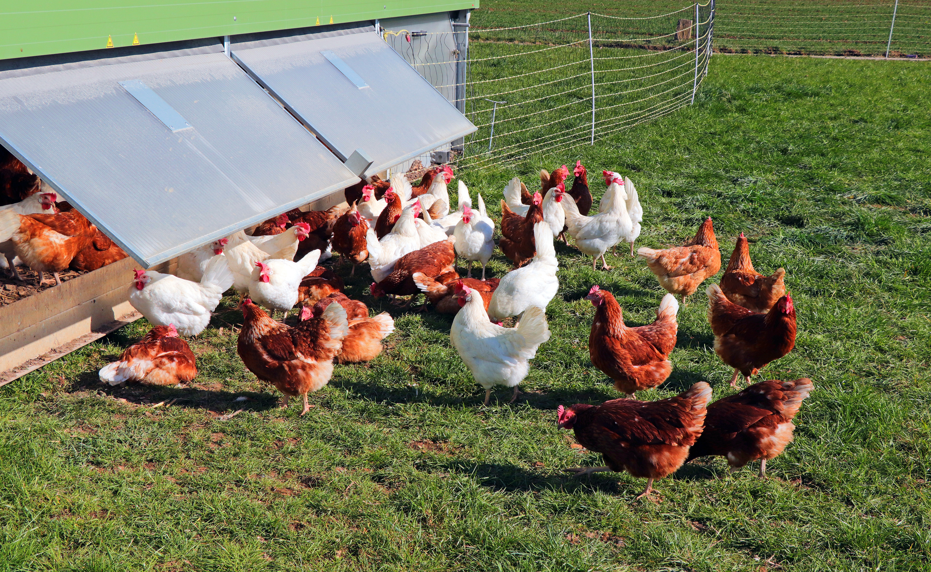
06/
Next steps
Promote awareness on the enviromental impact caused by certain types of food and propose alternative options.

Slide 18
Institute of Data
Thanks
Vagner Bauer

